Slide 1
US Superstore
Analysis Project

Slide 2
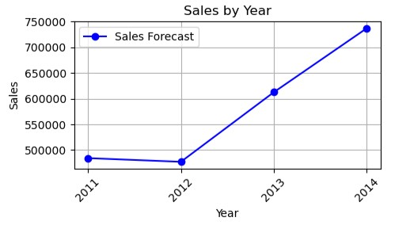
Sales Forecast
From the chart, we can conclude that sales will continue to increase.

Slide 3

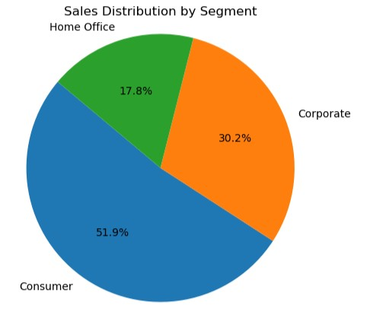
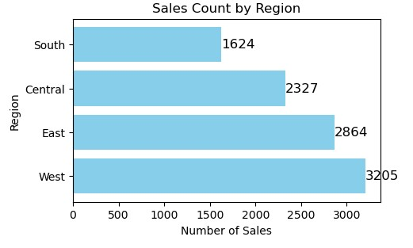
Customer Segmentation
Consumers make up the bulk of US Superstore's audience, according to their shopping behaviour, demographics, and purchase history. In that order, the West, East, Central, and South regions of the United States have the largest sales. Furthermore, in terms of sales, office supplies are the most popular product category, followed by furniture and technology for all client groups. Only the Consumer category employs First Class postage, whereas the majority of sales in all other categories use standard shipping. Finally, same-day delivery is seldom used in the Consumer, Corporate, and Home Office consumer groups.

Slide 4
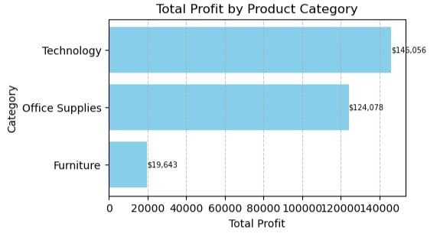



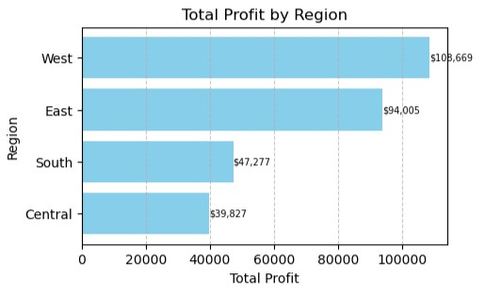
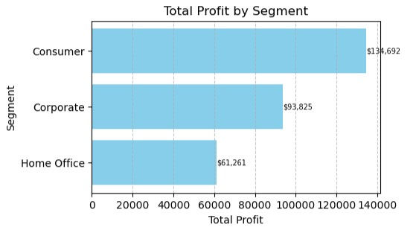

Profitability Analysis

Slide 5
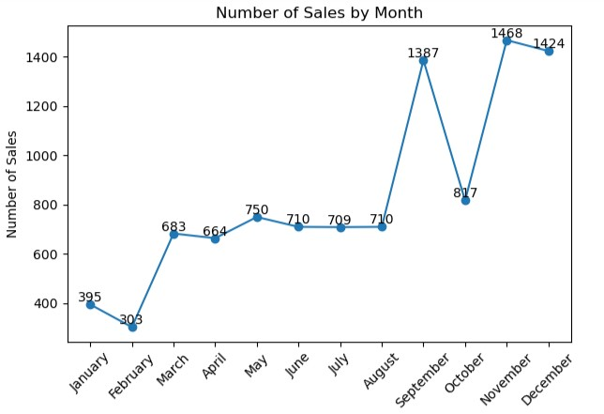
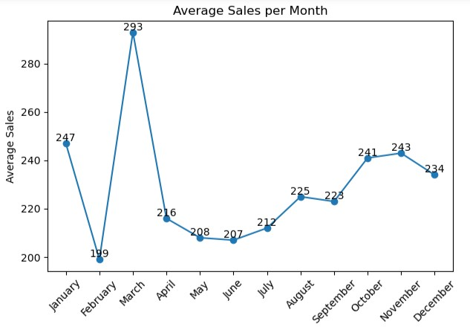
Inventory Management
The first chart shows that total number of sales increases toward the end of each year especially November and December.
The second chart shows the average number of sales in each month.
These should be used to manage demand.

Slide 6
Marketing Strategies
Target marketing efforts on the West area of the US, which has the largest sales. Increase sales in this area using regional specials, collaborations, or localised advertising. Monitor market rivals, particularly in the West too, and adjust your plan to remain ahead. Price matching, superior customer service, or unique products are examples.
Promote bundle packages, unique discounts, and special promotions to boost sales of.
Offer free or cheap shipping for big orders in these sectors to promote greater purchases.
Identify strategies to enhance attractiveness for same day delivery. This might include speedier processing, larger delivery locations, or lower service rates.
Customer input should be ongoing to understand shifting demands and preferences. Change and enhance the marketing plan using this input.

Slide 7
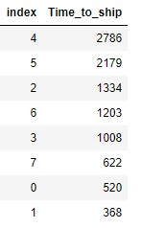
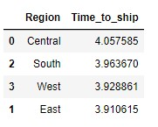
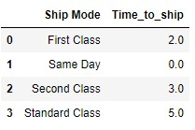

Supply Chain Efficiency
The top left explains the frequency of time it takes to ship products after they are ordered.
Bottom left explains the average time to ship based on the ship mode.
Top right explains average time to ship to each region.
Bottom right shows the number of sales that exceeded the average time to ship. It also concluded that this only happens in standard class mode.

Slide 8
Customer Retention
Consider offering subscription services for regularly purchased items. This ensures recurring business.
Deliver great customer service that exceeds expectations. Fast service, problem-solving, and friendliness may boost client loyalty.
Reduce cost
Offer unique discounts or promotions to current consumers. Make returning customers feel unique and valued.

Slide 9
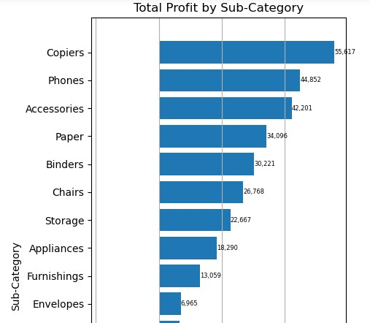
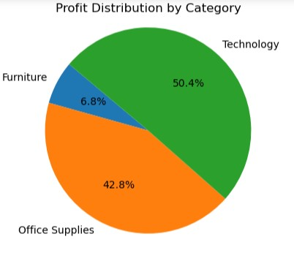
Cost Reduction
The bar chart visualizes product sub-categories with high profits (The top being Copiers, then, phones, accessories). This could be leveraged by reducing profit margin of these products to achieve cost reduction.
Also, by product category, Technology contributes to half of total profit, followed by Office supplies. Cost reduction could be applied here too.

Slide 10
Recommendations
Incorporate social responsibility programmes that connect with your target demographic. Customers with similar values are more loyal.
Collect customer input on their retail experience. Address complaints and utilise comments to enhance services. This tells consumers their views matter.
Maintain consistent branding and message across all mediums. This strengthens brand identification and client trust.
Use data analytics to deliver personalised product suggestions based on consumer purchasing history. This improves shopping and encourages repeat purchases.
Find ways to adjust all standard ship mode to 5 days, at most.

